Slide 1
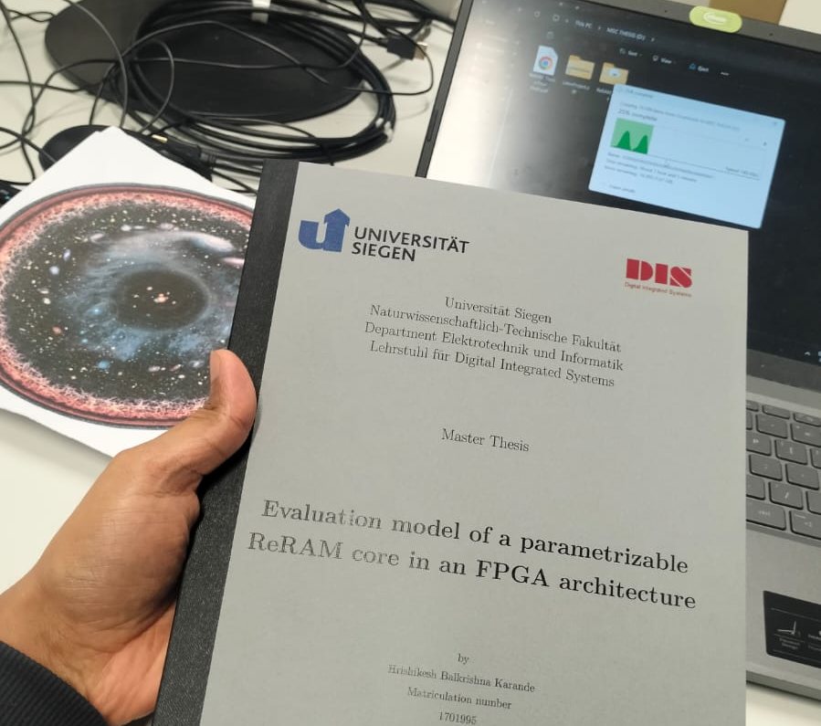

Evaluation model of a parametrizable ReRAM core in an FPGA architecture
Presentation for Master Thesis Defense
Hrishikesh Balkrishna Karande, Matriculation number 1701995
1st Examiner Prof. Dr.-Ing. Michael Wahl
2nd Examiner Prof. Dr.-Ing. Bing Li
Notes:
Good morning, everyone. Thank you, Prof. Wahl and Prof. Li, for serving as my examiners today.
My name is Hrishikesh Karande, and I am presenting my Master's Thesis: "Evaluation model of a parametrizable ReRAM core in an FPGA architecture."
This work aims to bridge the gap between theoretical models of emerging memory and practical system-level hardware evaluation.

Slide 2
Outline
Background & Motivation
Problem Statement
Thesis objectives
ReRAM properties
Modelling Strategy
Implementation
Results and Validation
Configuration Testing
Power Analysis
Future Work
Achievements
Notes:
I will begin by discussing the motivation and problem statement, followed by the specific objectives of this thesis.
Then, I will cover the ReRAM fundamentals and the hierarchical modeling strategy.
Finally, I will present the implementation details, simulation and hardware validation results, and directions for future work.

Slide 3
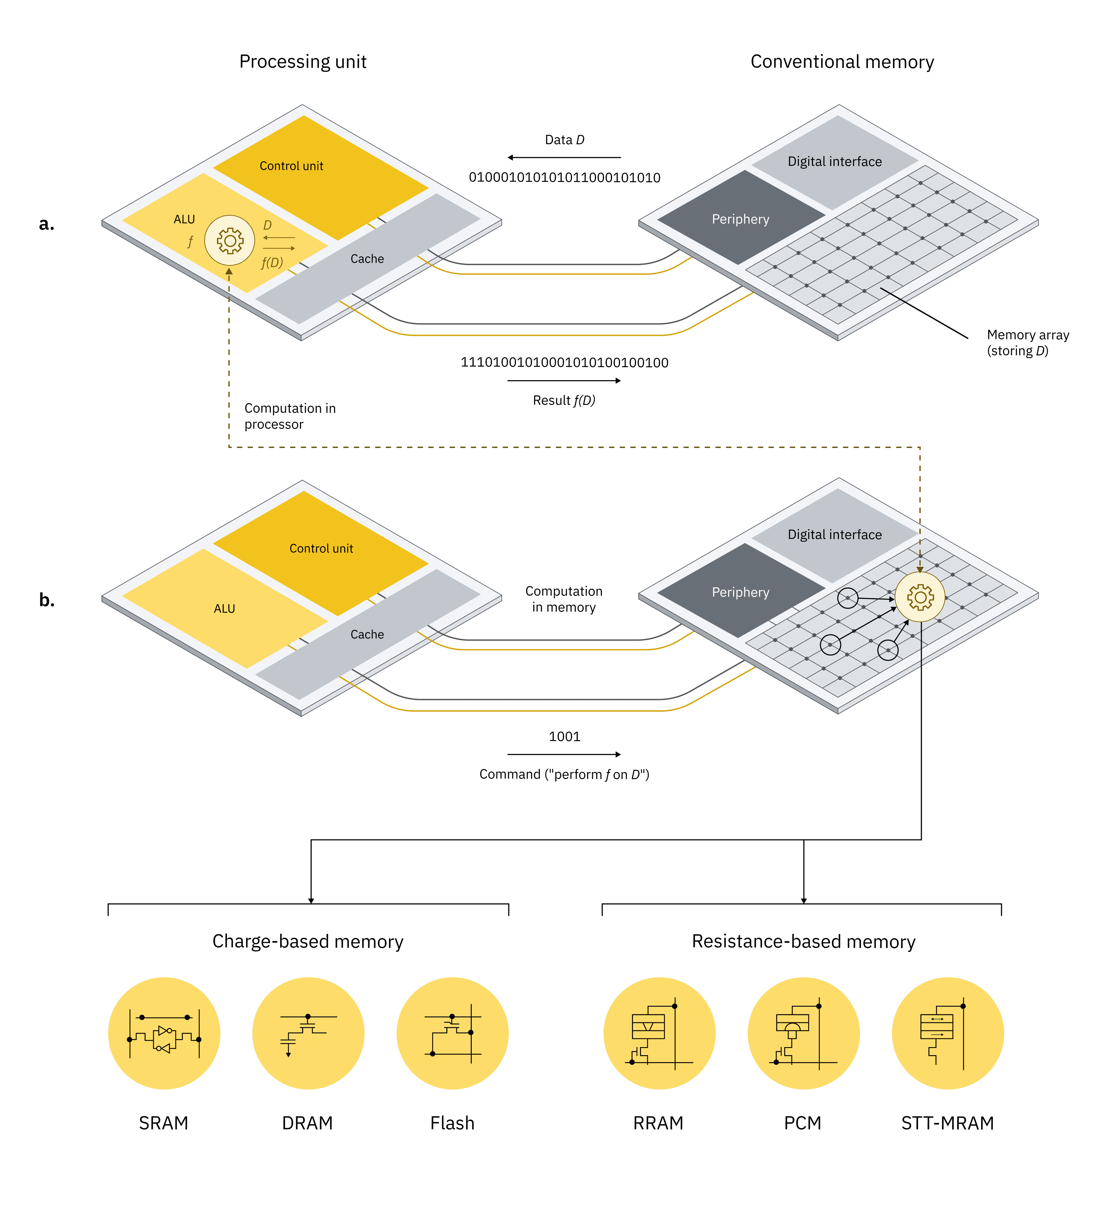
Background & Motivation
The Challenge: The Memory Wall
Von Neumann Bottleneck: In conventional systems image a, Data D must move to the processor to be computed (f).
High Cost: This data movement dominates execution time and consumes 60-80% of total system energy in data-intensive tasks like AI.
The Solution: Processing-in-Memory (PIM)
Compute-in-Place: As shown in image b, PIM performs operations f(D) directly within the memory array.
Efficiency: Exploits physical device attributes to compute, eliminating the latency and energy cost of moving Data D.
Why ReRAM?
While SRAM/DRAM are volatile, ReRAM (Resistance-based) offers non-volatility, high density, and efficient analog computation for PIM architectures.
Notes:
We begin with the "Memory Wall" problem, driven by the Von Neumann bottleneck. In image A, data (D) must constantly move between the memory and the Processing Unit (ALU) for computation, consuming 60-80% of total system energy in data-intensive tasks like AI.
The Solution is Processing-in-Memory (PIM). As shown in image B, PIM performs computation in situ, directly within the memory array, eliminating expensive data transfers.
Our Focus: ReRAM. Unlike volatile memories, ReRAM offers non-volatility, high density, and most importantly, the resistance-based switching needed to perform efficient analog and digital PIM operations.

Slide 4
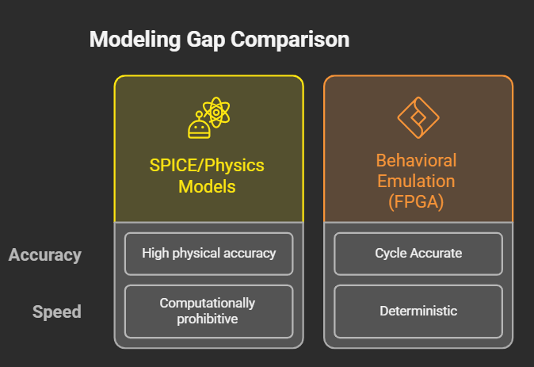
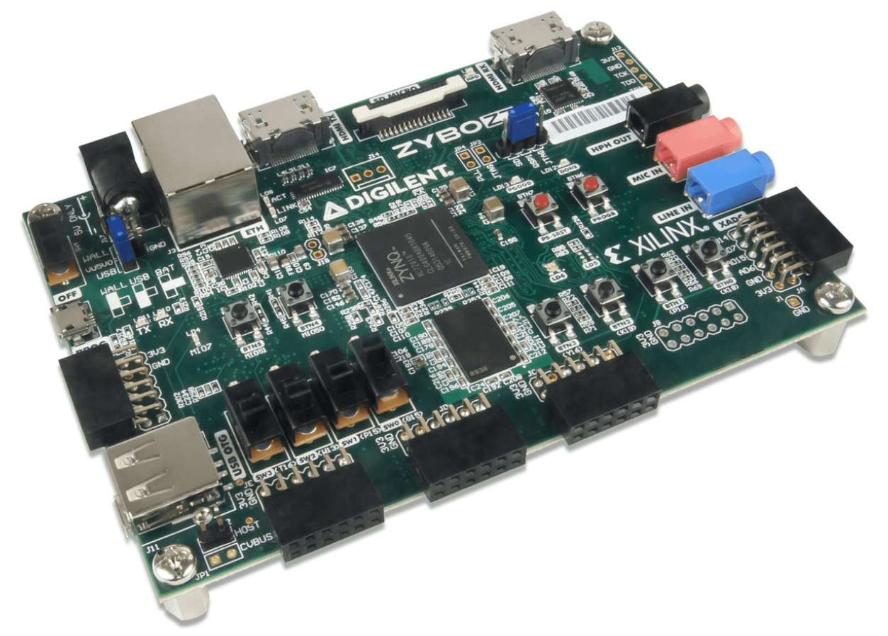
Problem Statement
The Barrier to Research
Physical Inaccessibility: Emerging ReRAM devices are not widely available for academic experimentation, and fabrication costs are prohibitive.
The Modeling Approach
Device-Level Models (SPICE): High physical accuracy but computationally too expensive for system-level simulation.
Software Simulators: Fast but often lack realistic timing, endurance constraints, and hardware interfaces.
The Need
A scalable, FPGA-based emulation platform that bridges the gap:
  Cycle-Accurate: Models real-world delays and wear-out.
  Hardware-Validated: Enables real-time hardware-software co-design.
Notes:
The barrier to research is the physical inaccessibility of emerging ReRAM devices.
We have detailed SPICE/Physics models that are highly accurate but computationally prohibitive for system design. We also have fast software simulators that lack the cycle-accurate realism needed for hardware-software co-design.
We require a flexible, FPGA-based emulation platform that can model real-world scenarios—such as timing and endurance—at a hardware level, allowing researchers to evaluate PIM architectures before costly fabrication.

Slide 5
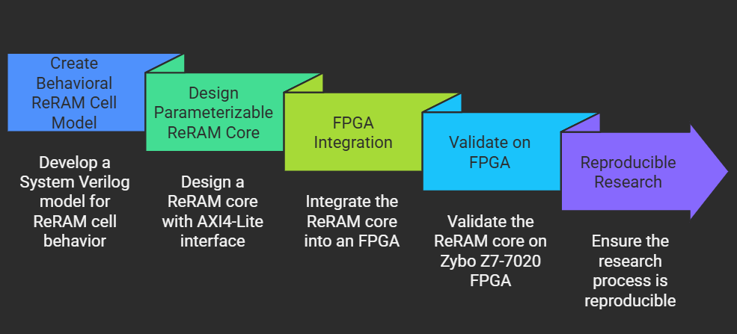
Thesis Research Objectives
Notes:
This thesis aimed to achieve five core objectives:
1. Behavioral Model: Develop a SystemVerilog model for a single ReRAM cell, incorporating crucial physical behaviors.
2. Parametrizable Core: Scale the model into an array with configuration parameters.
3. FPGA Integration: Implement the core on the Zybo Z7-7020 and interface it with the ARM processor via the AXI4-Lite protocol.
4. Validation: Prove functional correctness via hardware-software co-design using a bare-metal C application.
5. Reproducible Research: Ensure all design files and documentation are open and reproducible.

Slide 6
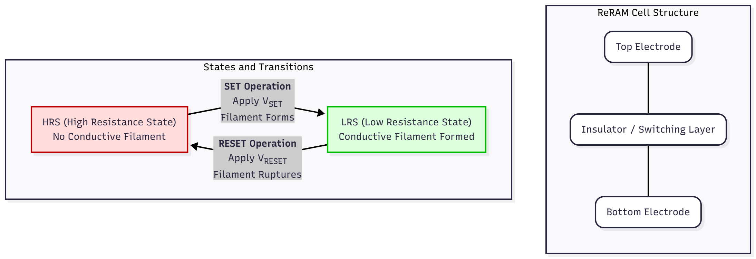
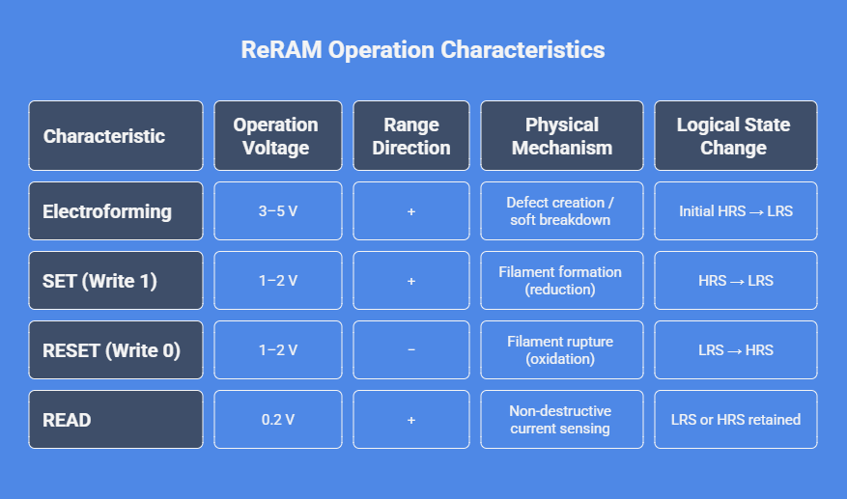
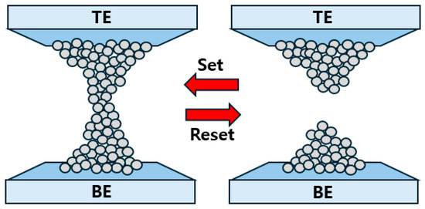
ReRAM Properties and working
Notes:
Let us have a look at the basic block diagram of a ReRAM. It has three different physical layers. TE SL and BE.
ReRAM devices store information by switching between two resistance states: High (HRS, Logic 0) and Low (LRS, Logic 1).
Mechanism: This switching involves the formation (SET operation) or rupture (RESET operation) of a conductive filament within the switching layer, typically driven by ion migration.
Characteristics (Table): Key takeaways in this table are the electroforming state which kick starts the device then the low operating voltage for Read, and observe that the reset requires reverse polarity.

Slide 7
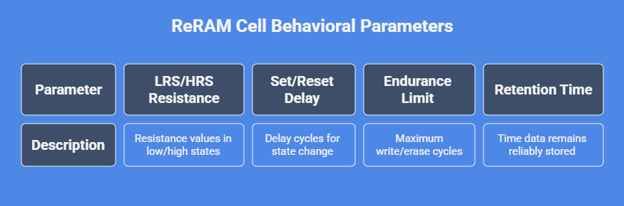
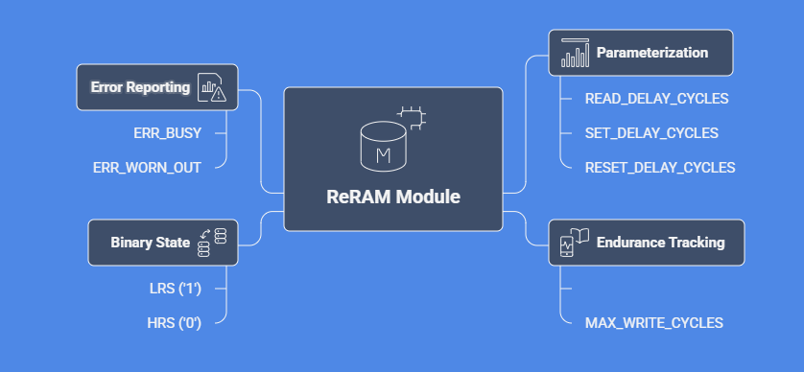
ReRAM Behavioural Modelling Strategy and Scaling Parameters
Notes:
Our strategy for behavioral modeling is simple. We abstract the complex physics into four synthesizable, configurable parameters:
LRS/HRS Resistance (binary state storage).
Set/Reset Delay (critical for cycle-accuracy).
Endurance Limit (tracking write wear-out).
Retention Time.
The ReRAM Module is a Finite State Machine that enforces these behaviors using internal counters, ensuring that operations block the system for the modeled physical delay and report errors when the endurance limit is met.

Slide 8
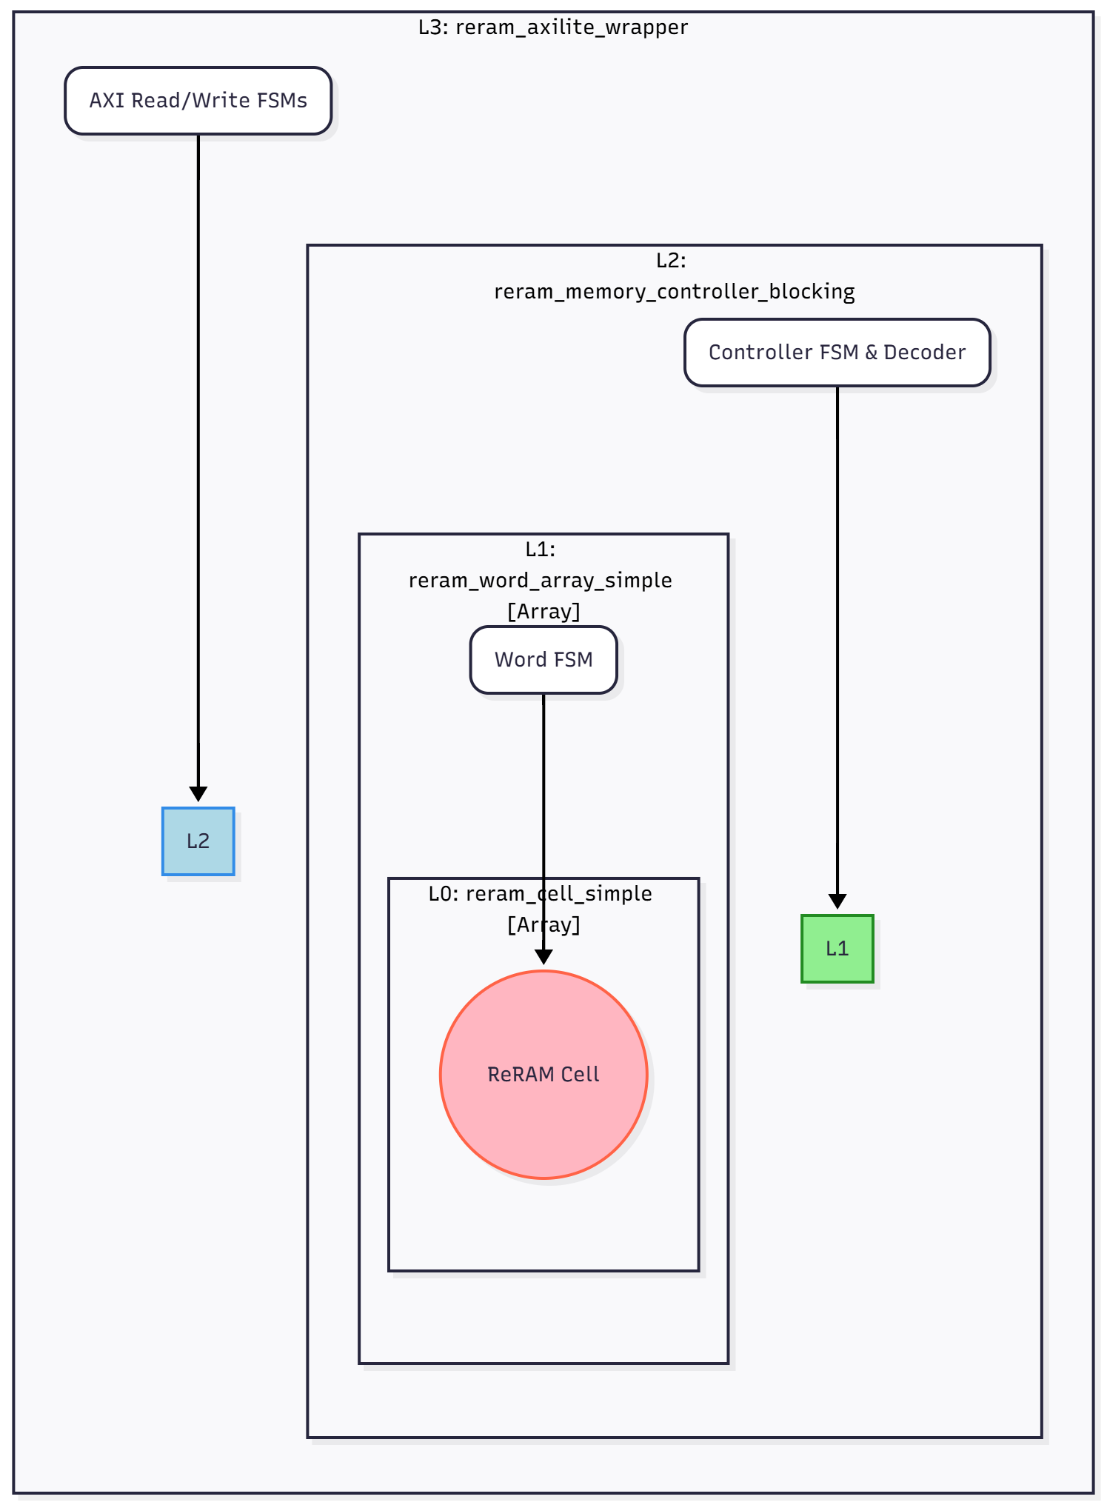
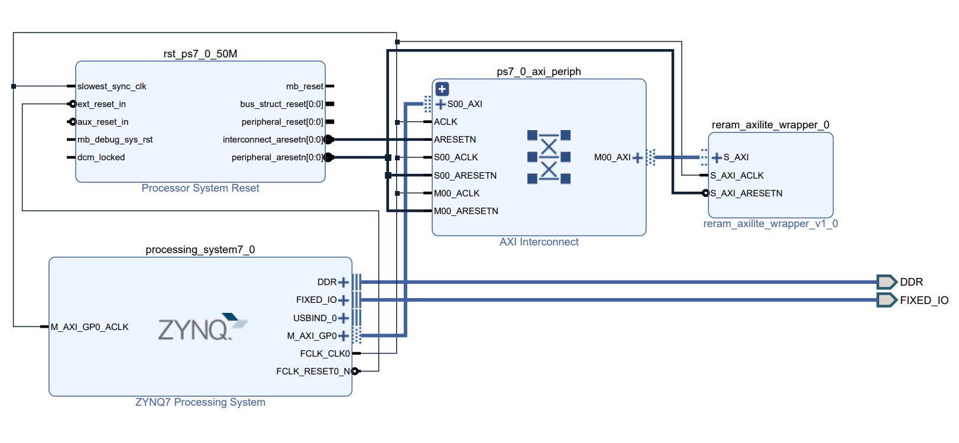
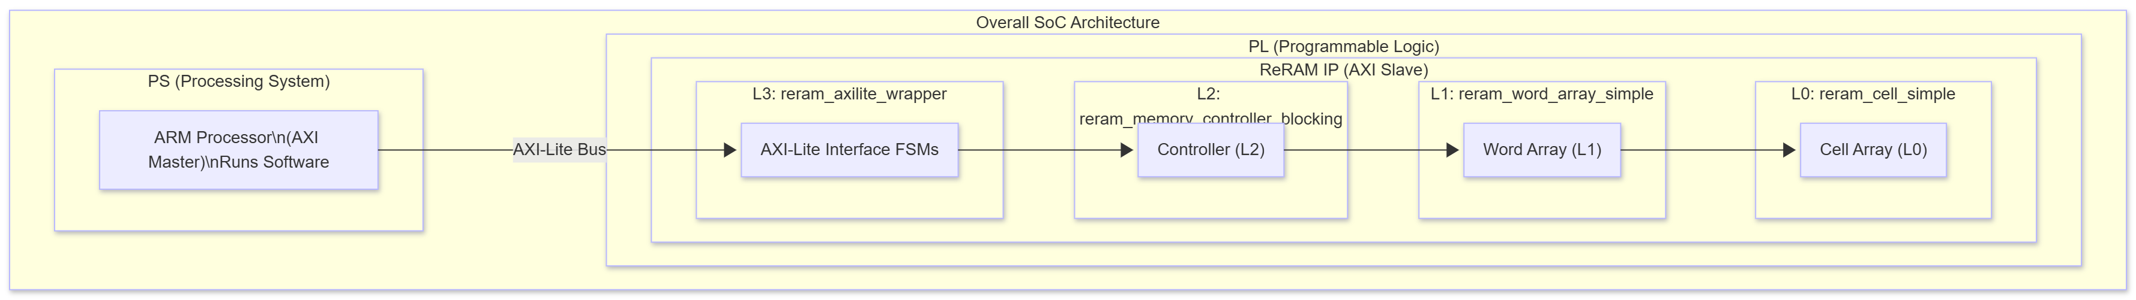
Implementation - System Architecture Overview
Notes:
The overall system is a Zynq SoC co-design. The ARM Processing System (PS) acts as the AXI Master, controlling our ReRAM IP in the Programmable Logic (PL) via the AXI-Lite bus.
Design Hierarchy (Bottom): We utilized a four-layer, bottom-up design to ensure modularity and scalability: from the atomic L0 Cell to the L3 AXI-Lite Wrapper that handles processor communication.

Slide 9
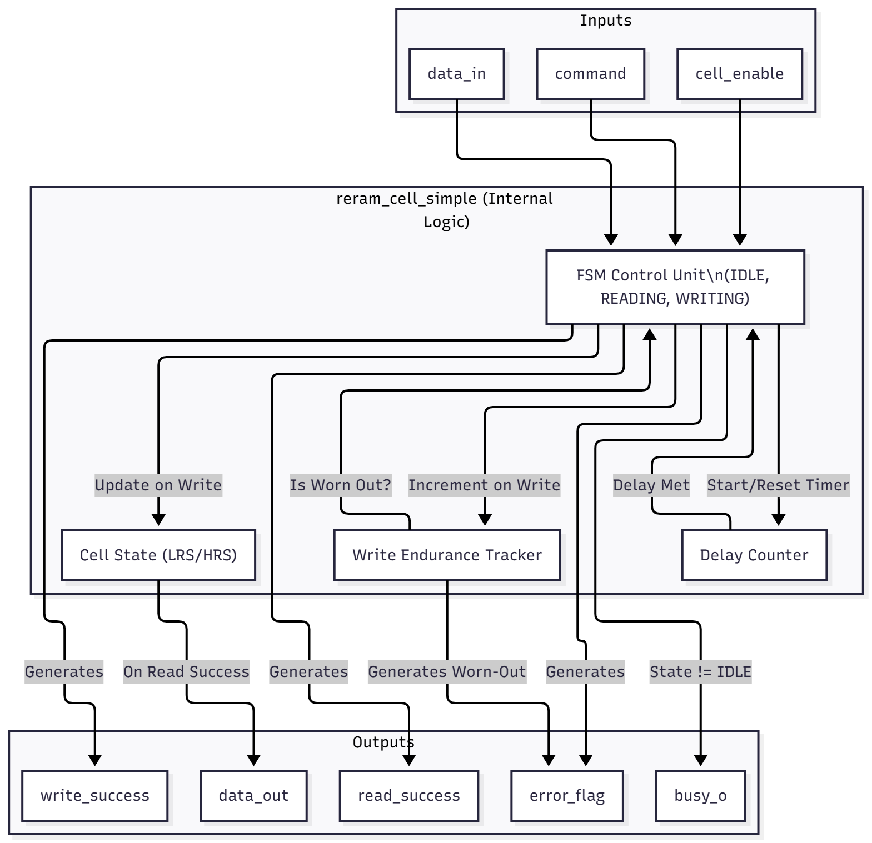
Implementation - Layer 0 - The ReRAM Cell
This is the atomic unit. It blocks operations until the simulated "physical delay" is over.
Logic: FSM with states (IDLE, READING, WRITING_SET, WRITING_RESET).
Features: Internal delay counter and Endurance counter.
Output: Data + Busy Flag + Error Flag (if worn out).
Notes:
Now let us look at the ReRAM hierarchical layers.
L0 is the atomic unit, implemented as a blocking Finite State Machine (FSM).
Function: It is responsible for the core logic: it holds the busy signal high until the internal delay counter meets the configured SET/RESET_DELAY_CYCLES.
It also maintains the Write Endurance Tracker, incrementing the counter on every successful write and asserting an error flag if the MAX_WRITE_CYCLES limit is exceeded. This accurately models device wear-out.

Slide 10
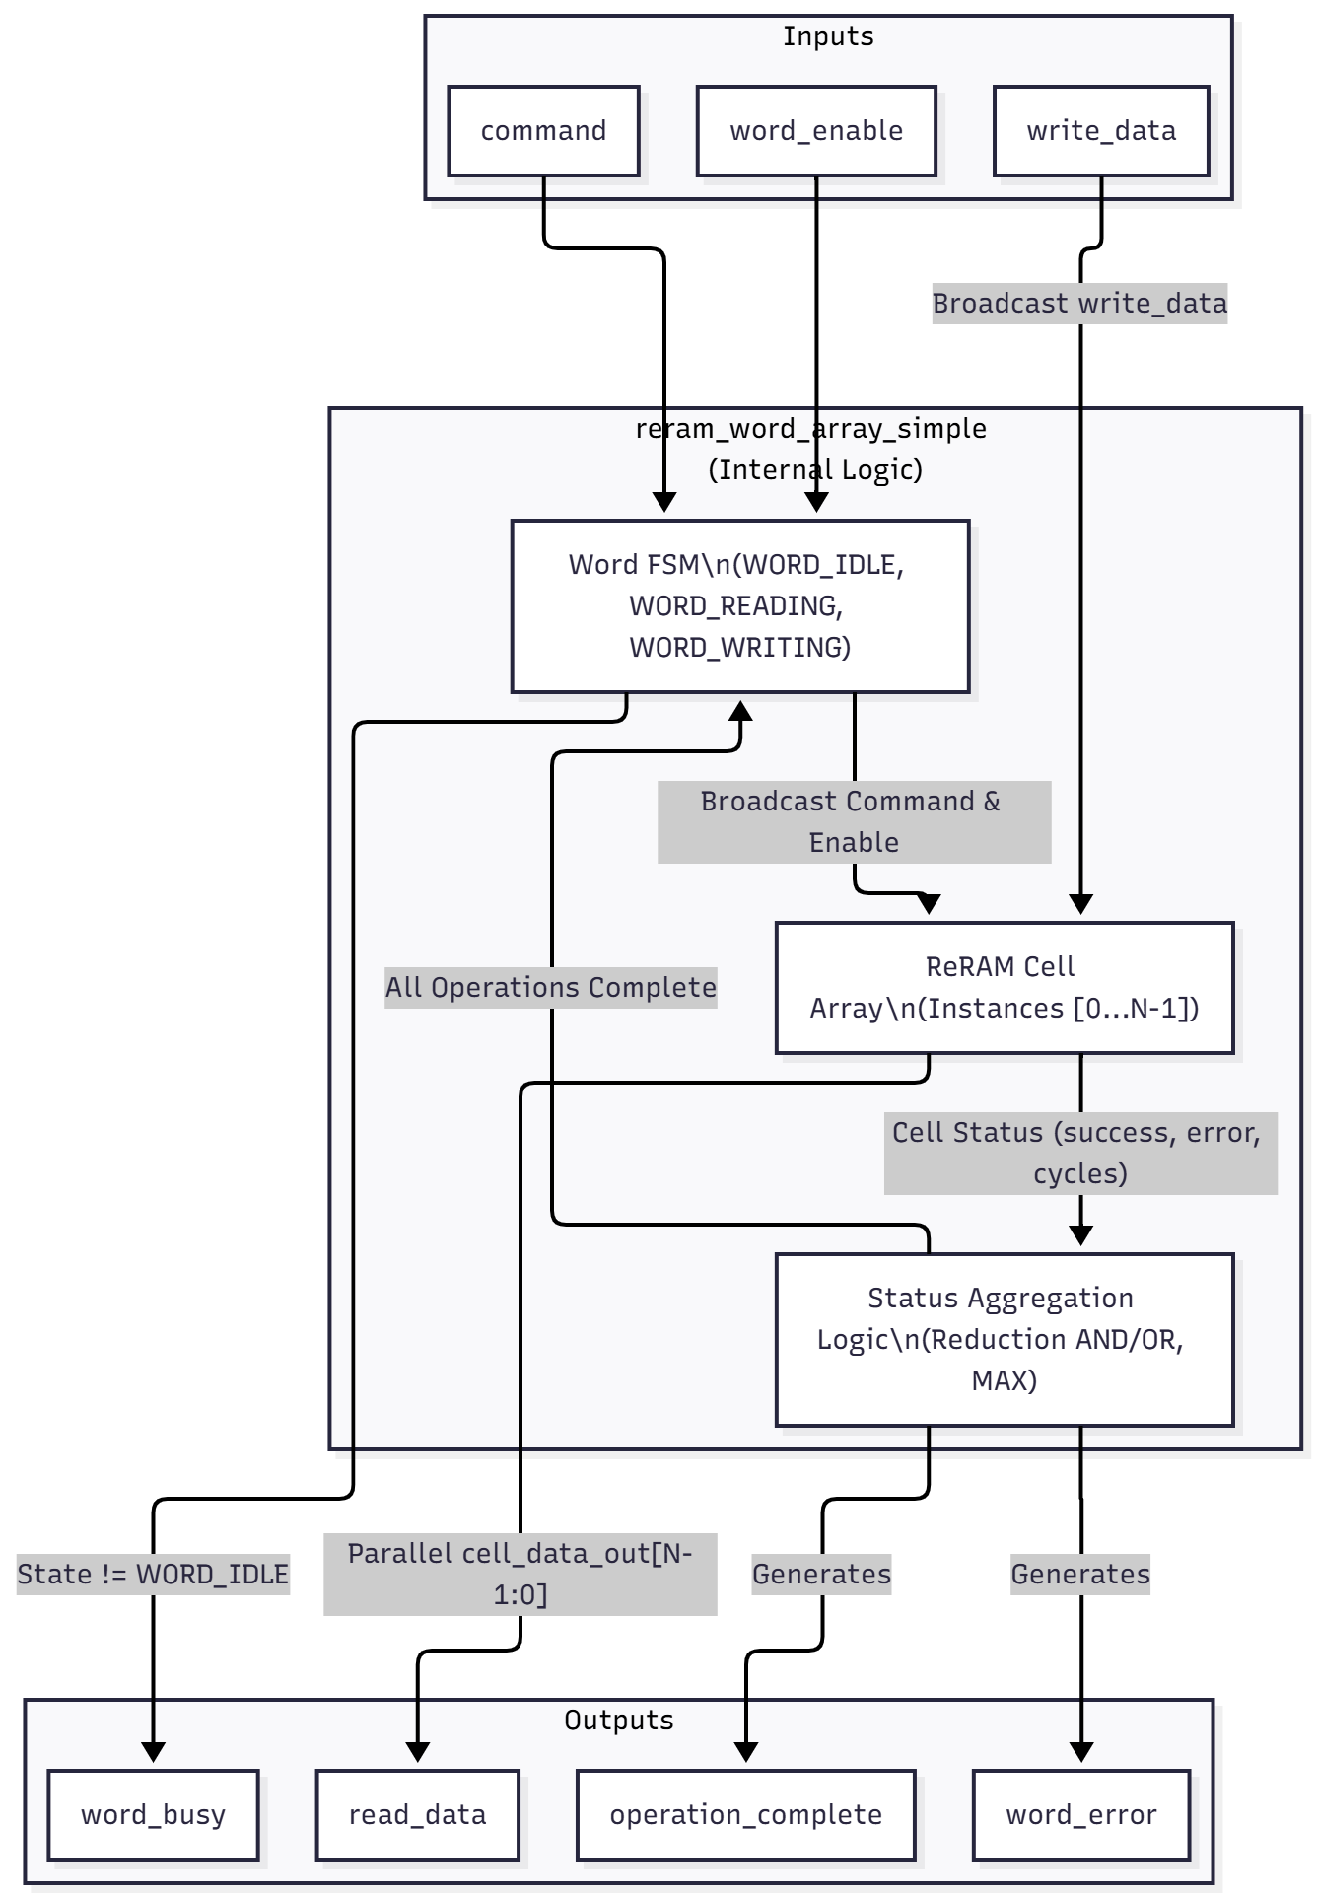
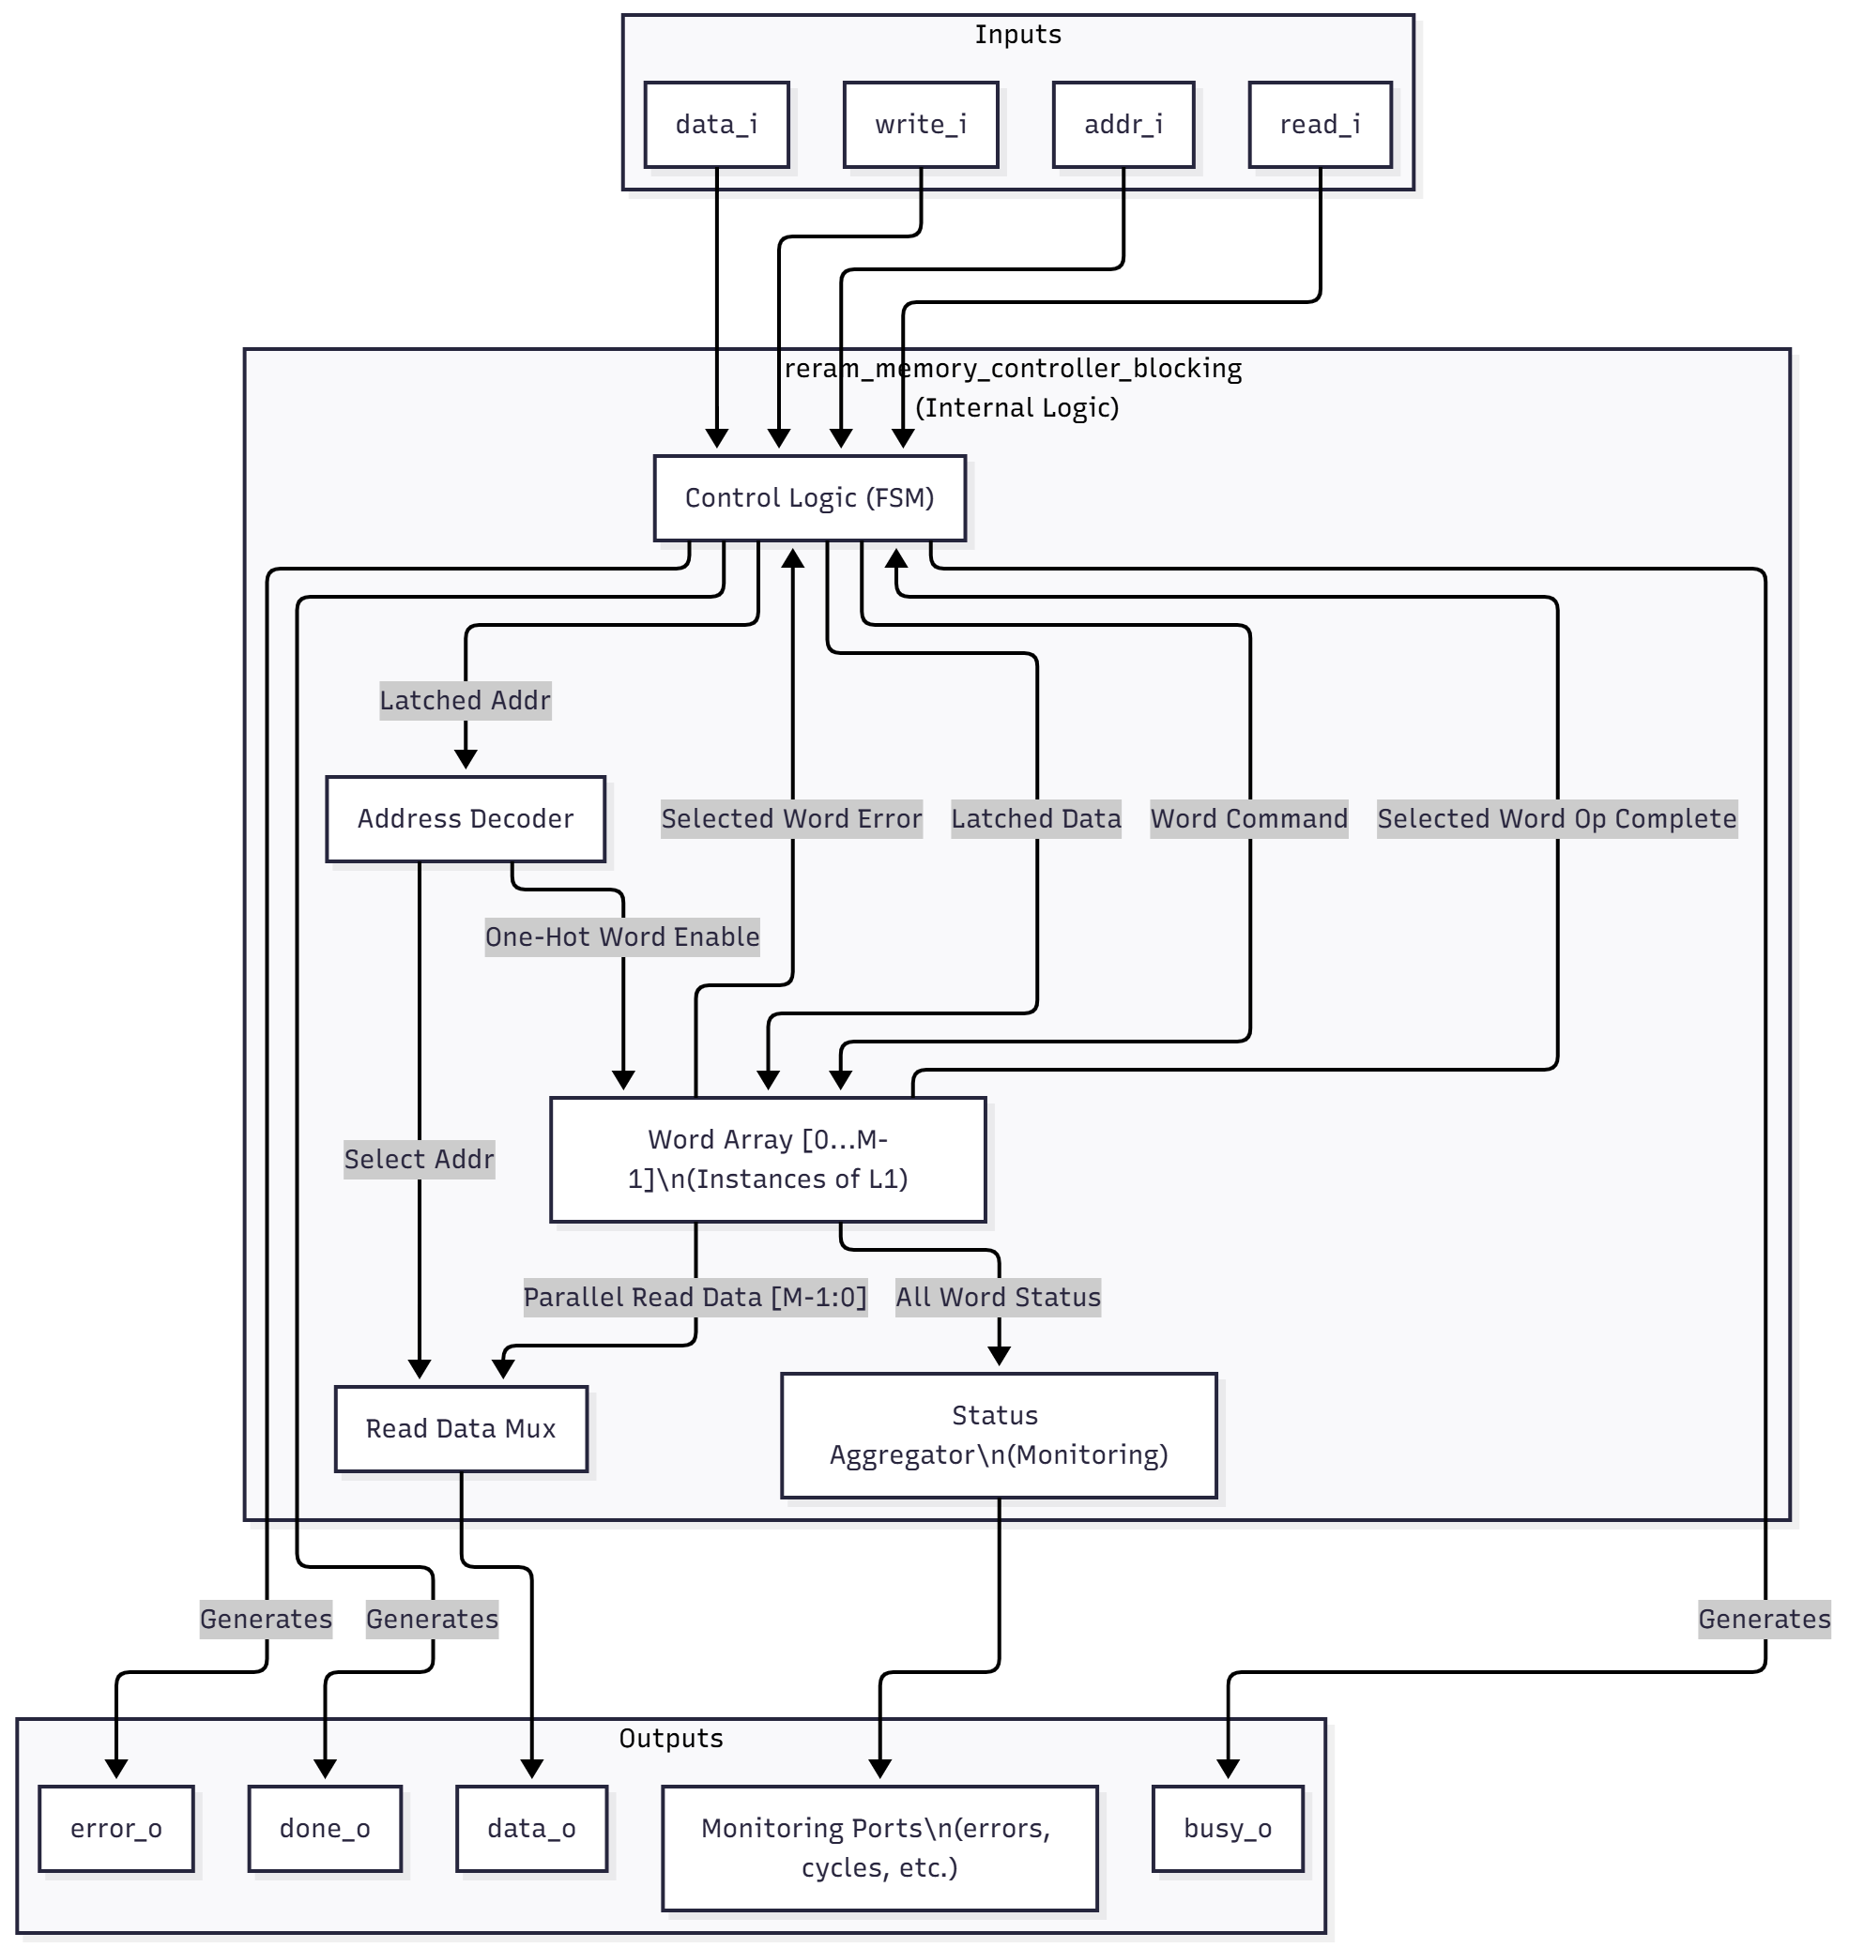
Implementation - Layer 1 & 2 - Word Array & Controller
How we scale from a single bit to a memory bank…
L1 (Word): Parallel instance of cells (e.g., 32-bit word).
L2 (Controller): Address decoding logic.
Blocking Interface: The controller holds the "Busy" signal high until the ReRAM cells finish switching.
Word Array
Controller
Notes:
L1 and L2 layers handle scaling and addressability.
L1 (Word Array): Aggregates L0 cells into a parallel word (e.g., 32 bits). Its crucial task is status aggregation: an operation is only complete when every cell in the word has finished or failed.
L2 (Controller): Scales L1 words into a full addressable memory bank. It provides a simple blocking read/write interface, using address decoding to select the specific L1 word array. The controller’s busy signal remains high until the longest cell operation in the selected word is complete.

Slide 11
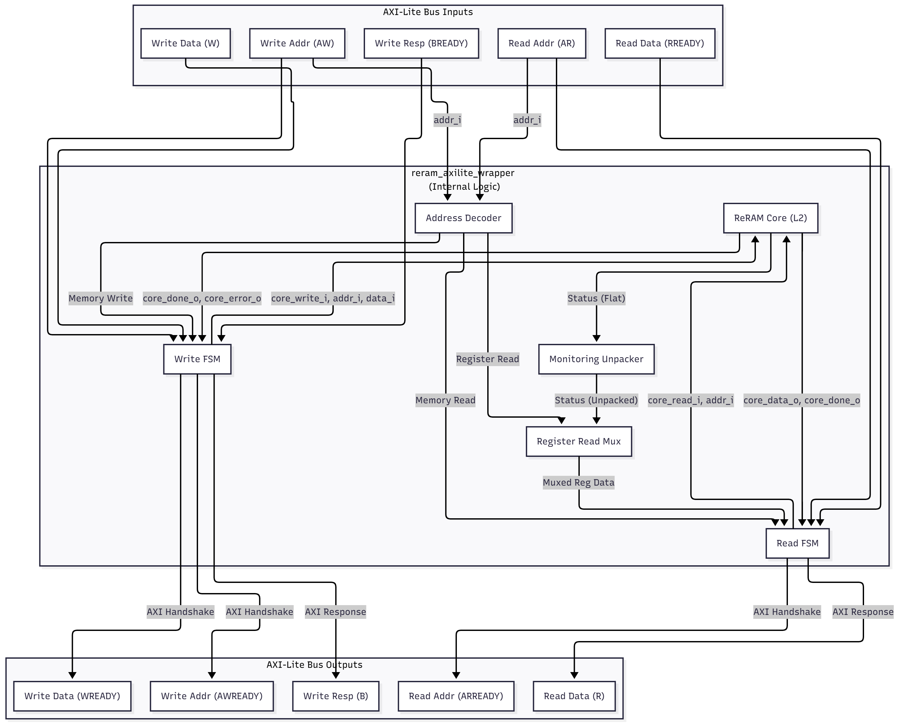
Implementation - Layer 3 - The AXI-Lite Wrapper
This is critical for system integration. It makes the ReRAM look like standard memory to the processor, but with realistic delays.
Function: Translates CPU instructions to ReRAM signals.
Memory Map: Separation of Memory Space vs. Register Space (Status/Endurance).
Notes:
This is the final layer, integrating our custom core into the standard SoC environment.
Function: It translates AXI-Lite's multi-cycle handshake into the single-pulse command interface required by the L2 core.
Address Map: It segregates accesses: Memory access triggers the blocking operation, while Register access provides immediate, non-blocking status reads (e.g., endurance counters).
Critical Mechanism: For memory transactions, the wrapper stalls the AXI bus by holding the response signal (S_AXI_BVALID/RVALID) low until the internal ReRAM core signals done_o. This enforces the cycle-accurate ReRAM latency on the processor.

Slide 12
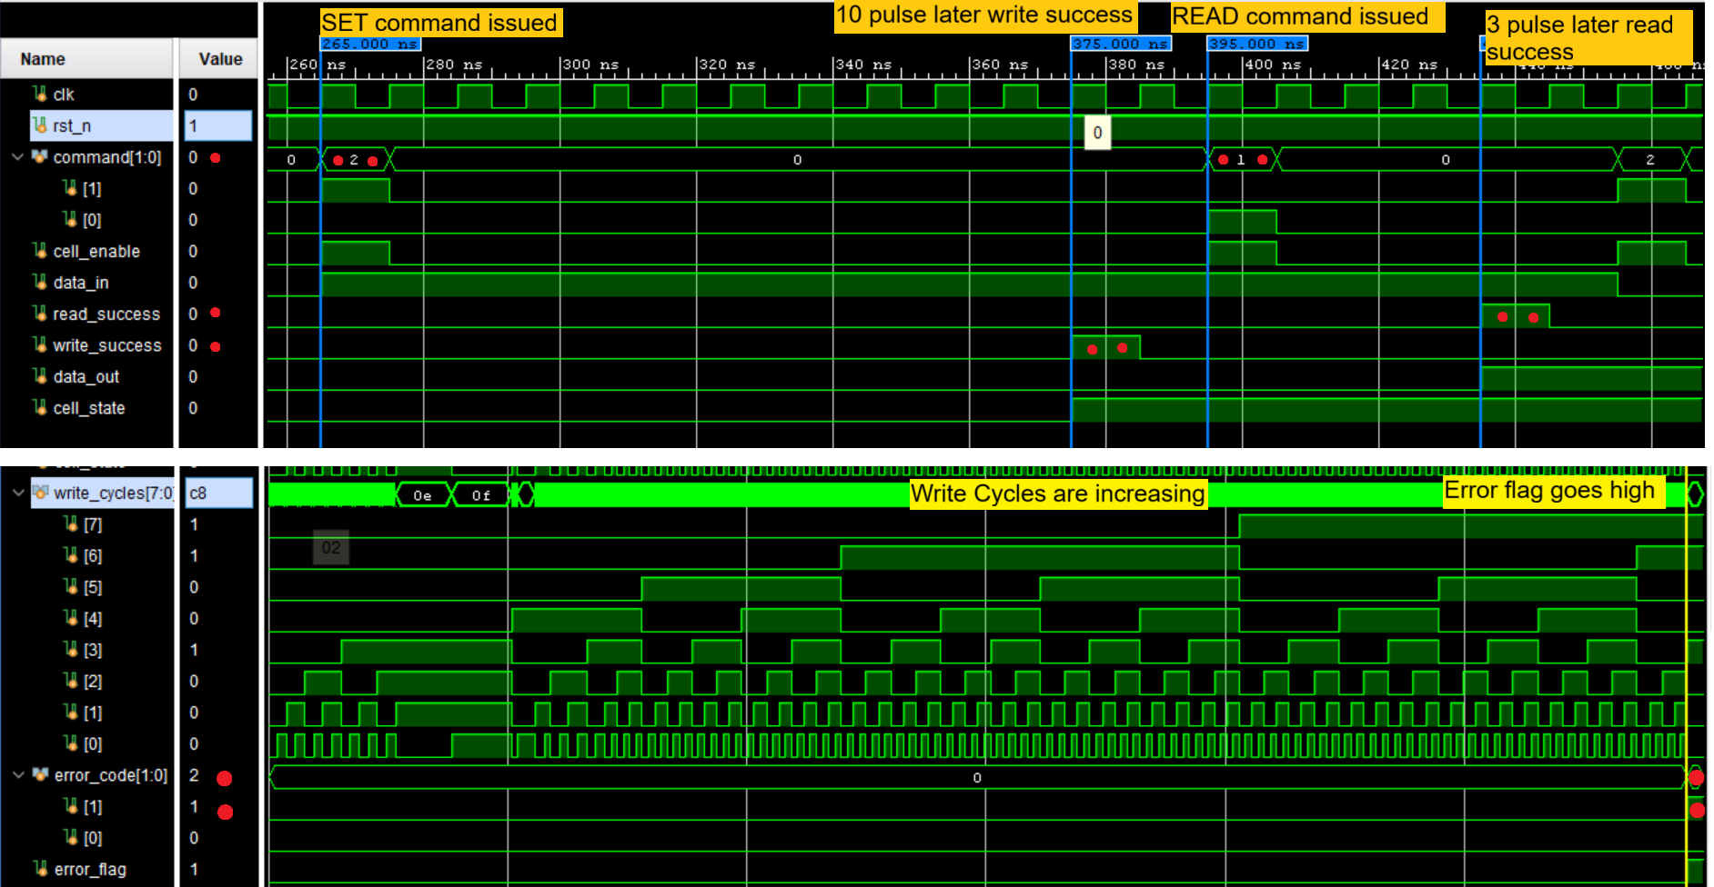
Results & Validation – It works in simulation!!!
Verification that the timing and wear-out logic works exactly as designed.
SET Command Issues -> Delay (Wait for 10 Clk Pulse) -> Write Success
Endurance Counter Incrementing
Notes:
We rigorously verified the design using SystemVerilog testbenches.
Timing Proof (Top Waveform): Here you see the core validation: A SET command is issued, and precisely 10 clock pulses later (matching the SET_DELAY parameter), the write_success pulse is generated. This confirms the cycle-accurate delay modeling is functional.
Endurance Proof (Bottom Waveform): The write_cycles counter increments with each operation, eventually causing the Error flag to assert, confirming the wear-out model is correctly implemented.

Slide 13
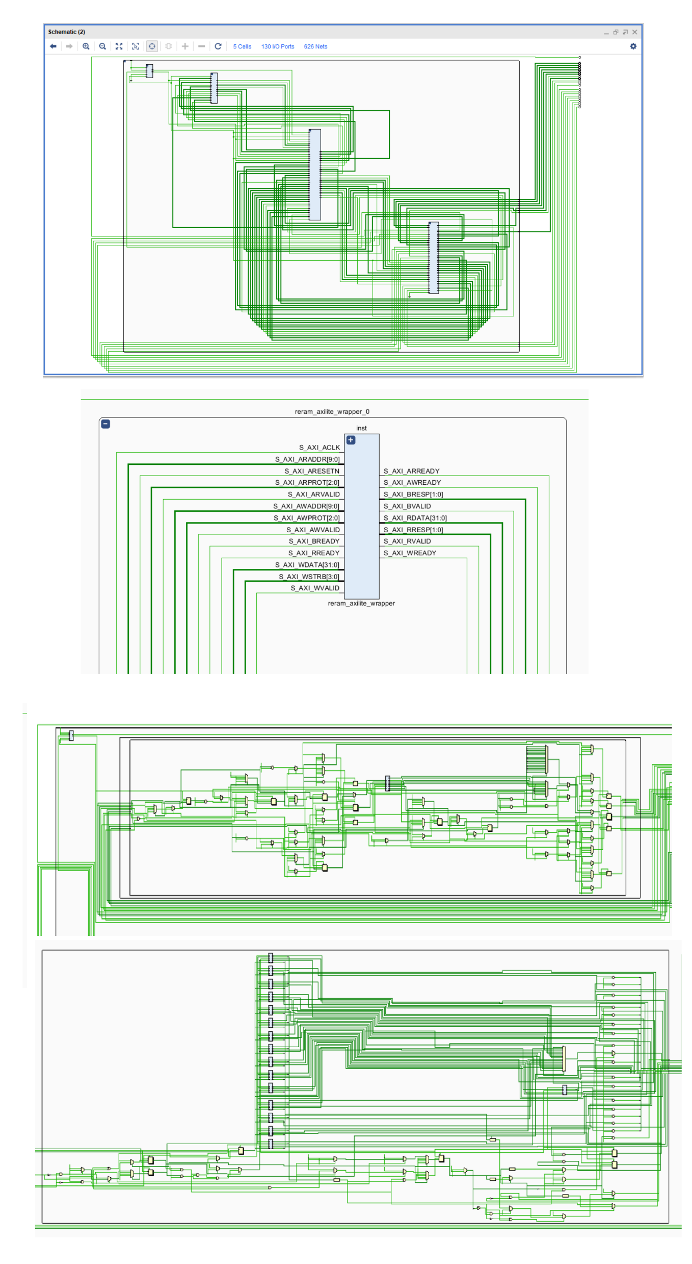
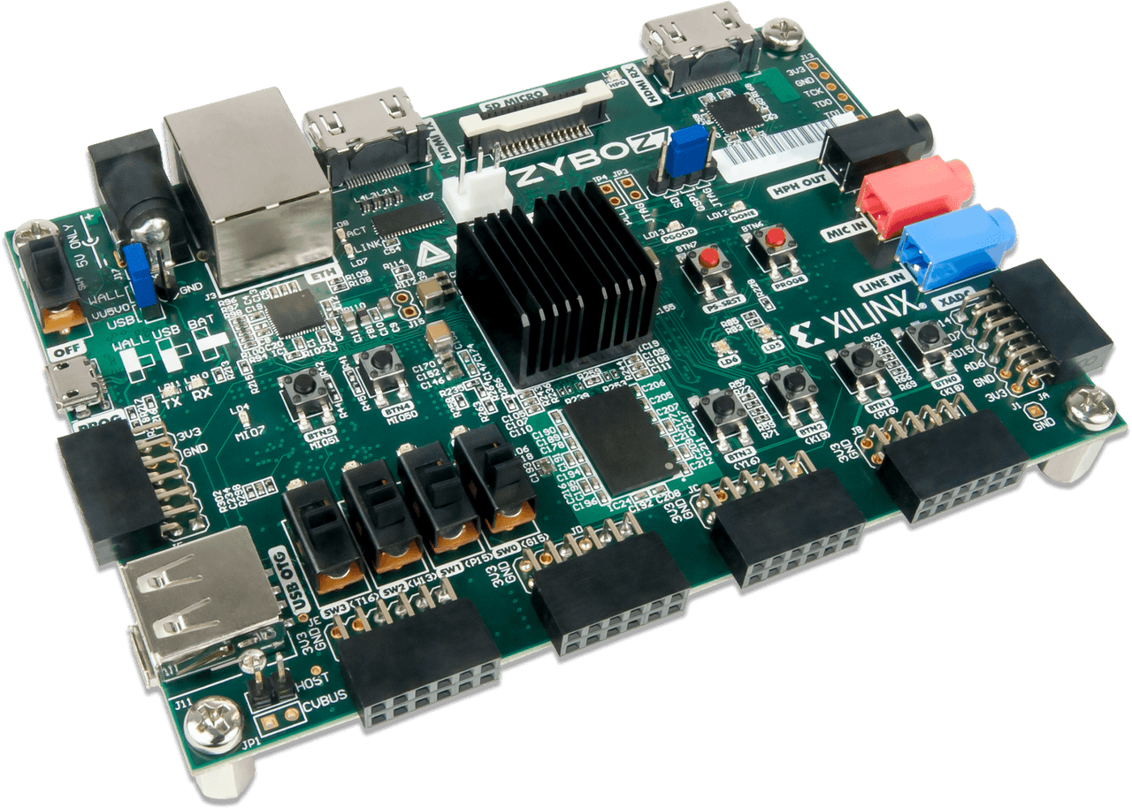
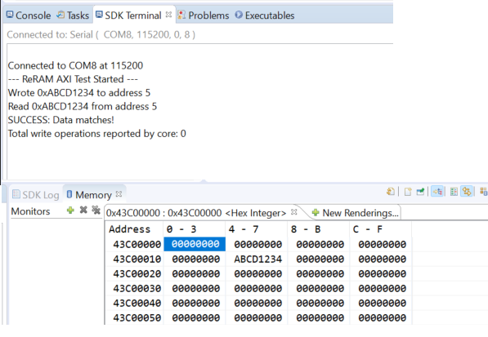
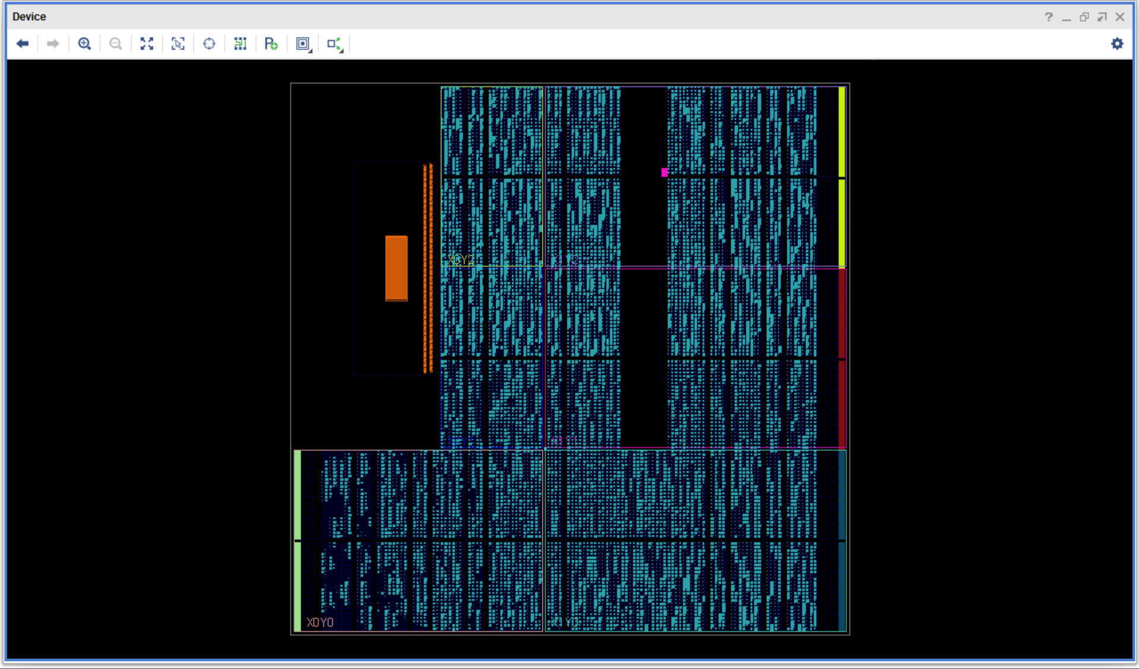
Results & Validation – It works in real silicon!!!
Notes:
After successful simulation, the design was synthesized and deployed on the Zybo Z7-7020 FPGA.
The schematics (top) confirm the design's successful mapping to the target hardware logic.
Hardware-Software Validation: The console output (bottom) shows the final, integrated success: The C-code application running on the ARM processor successfully writes a pattern (0xABCD1234) to address 5, reads it back, and confirms data matches. This validates the entire complex hardware-software co-design flow.

Slide 14
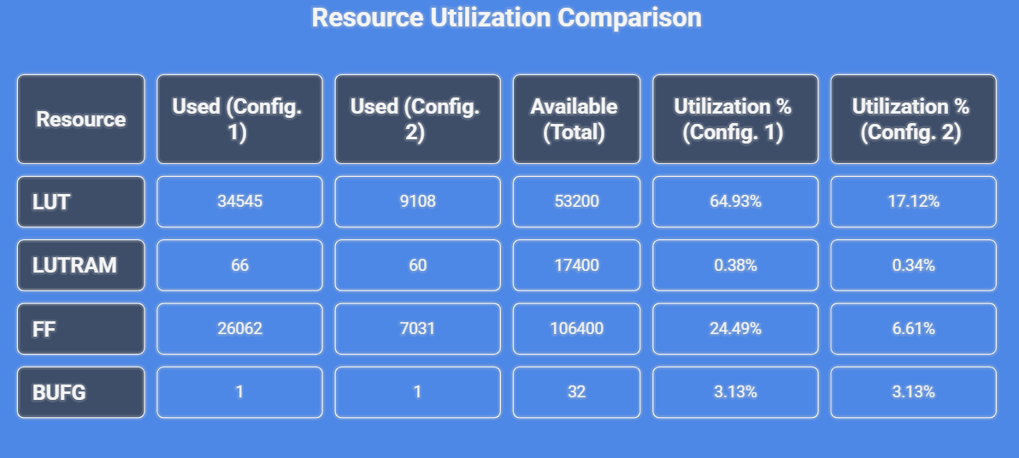
Testing the model on 2 different Configuration sizes
Because every cell is an independent model, the core scales linearly. We can simulate larger arrays by simply changing the MEMORY_DEPTH parameter.
The total number of emulated ReRAM cells was reduced from 512 (16x32) in Config. 1 to 128 (8x16) in Config. 2, a 75% reduction.
LUT utilization decreased from 34545 to 9108, a reduction of 73.6%.
FF utilization decreased from 26062 to 7031, a reduction of 73.0%.
Notes:
To test scalability, we compared a 512-cell core (Config. 1) against a 128-cell core (Config. 2).
Key Finding: A 75% reduction in emulated cells resulted in a proportional, linear reduction of approximately 73% in LUT and FF utilization.
Conclusion: This confirms our behavioral approach is scalable, as the resource cost is directly proportional to the number of cell FSMs and counters we choose to emulate in the logic fabric.

Slide 15
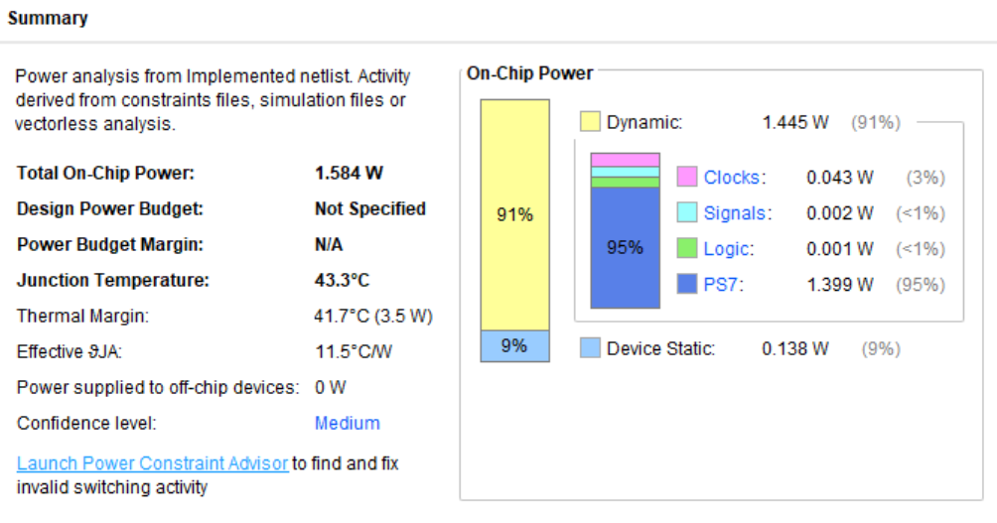
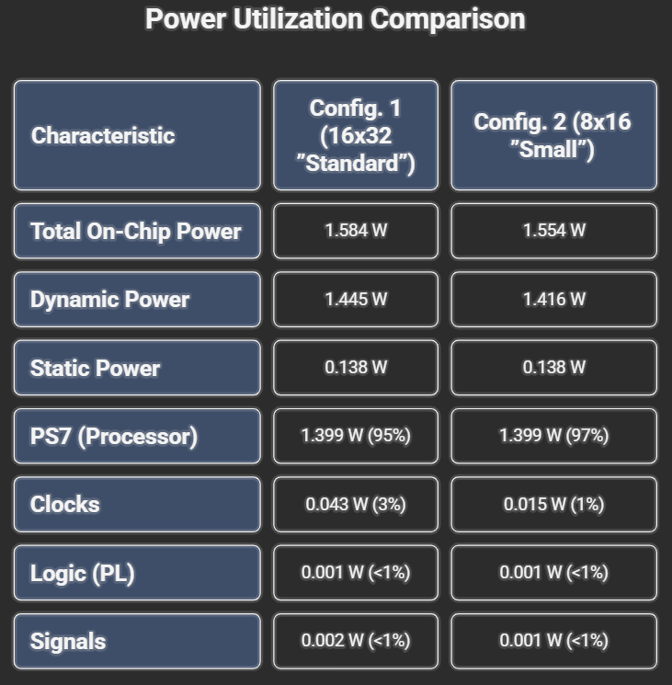
Power Utilization Comparison
Very low power for the IP (<1mW dynamic).
Notes:
The power analysis shows that the total on-chip power is overwhelmingly dominated by the ARM Processor (95% of dynamic power).
Key Insight: The power consumed by our custom ReRAM emulation logic (the "Logic" component) is negligible, at only 0.001 Watts.
Conclusion: This is a crucial finding. It means that the platform is extremely power-efficient for emulation, allowing future researchers to focus entirely on the power-performance tradeoffs of the processor and application, without the emulation model itself distorting the power budget.

Slide 16
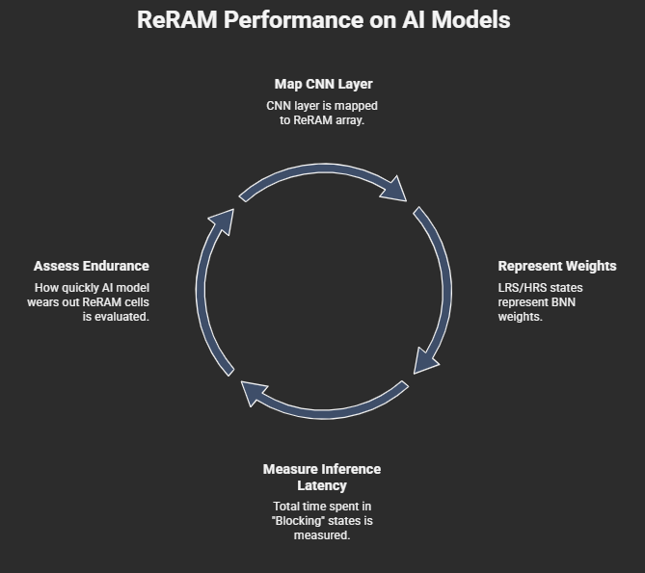
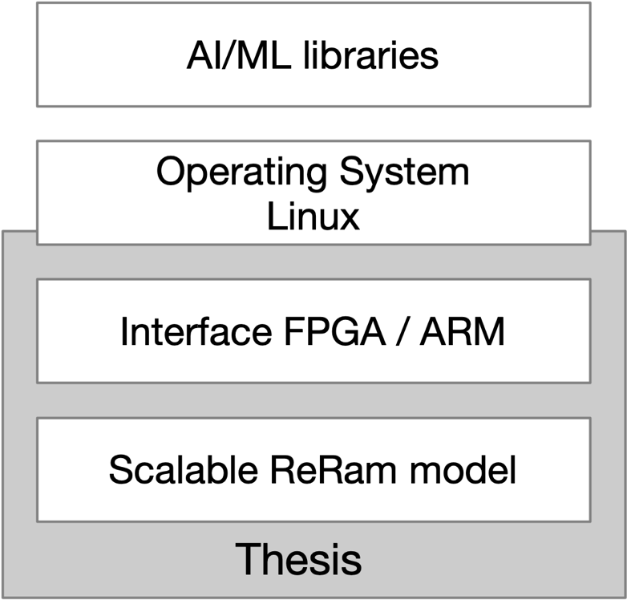
Future Work
Mapping: How a CNN layer maps to the ReRAM array.
Conductance: LRS/HRS states represent Binary Neural Network (BNN) weights.
Analysis: Using this FPGA core to measure:
Inference Latency: Total time spent in "Blocking" states during a matrix multiply.
Endurance/Lifetime: How quickly a specific AI model (e.g. Linear Regression) wears out the ReRAM cells during training updates.
Notes:
This validated core forms a stable foundation for the next phase of research.
Primary Goal: Transition from a memory model to a Processing-in-Memory accelerator for AI.
Mapping: The core can be used to model how a CNN layer maps onto a ReRAM crossbar.
Analysis: We can now accurately measure Inference Latency (total time spent in blocking states) and Endurance/Lifetime (how quickly AI training workloads wear out the cells) in a realistic hardware environment.

Slide 17
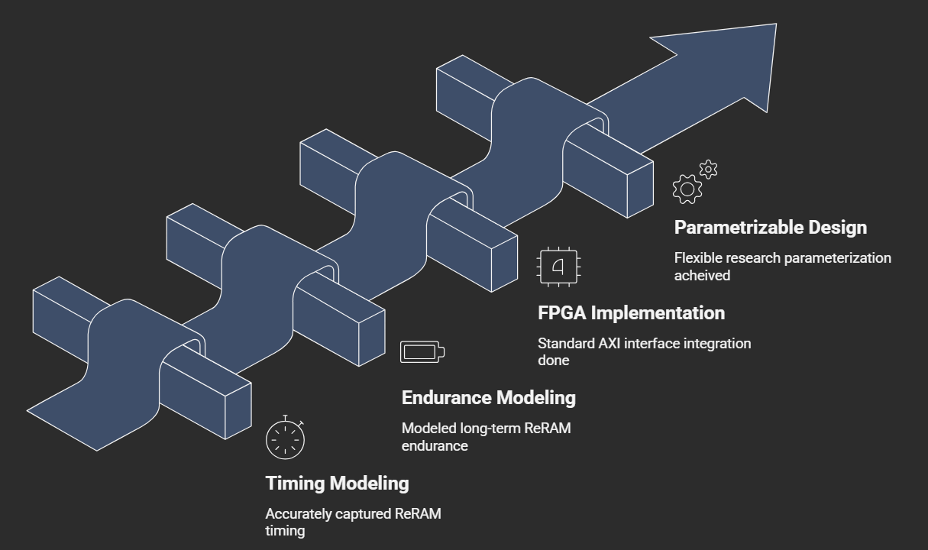
Achievements
Notes:
In summary, this thesis delivered a validated, reproducible ReRAM evaluation platform, achieving:
Timing Modeling: Cycle-accurate latency capture.
Endurance Modeling: Realistic wear-out tracking.
FPGA Implementation: Standard AXI integration with an embedded processor.
Parametrizable Design: A flexible foundation for future architecture exploration.

Slide 18

Documentation, Research Material and Source Code Access
https://github.com/hrishikeshkarande/CNN-ReRAM_on_FPGA.git
Notes:
My commitment to reproducible research means all SystemVerilog source code, testbenches, and hardware/software documentation are available on the GitHub repository listed here.

Slide 19

Thank You
Contact
Hrishikesh Karande
hrishikesh.karande@student.uni-siegen.de
Notes:
This concludes my presentation. Thank you for your attention. I am now ready for your questions.

